Slide 1
Final Project Presentation
EE / CprE / SE 491 – sddec20-proj01
Machine learning for pilot biometrics
Team Members:
Jianhang Liu, Feng Lin, Xuewen Jiang, Xiuyuan Guo, Sicheng Zeng, Junjie Chen

Slide 2
Introduction
Problem:
Hypoxia, Fatigue, Strain Doubles would cause pilots to crush their airplane, huge losses economically and not to mention they put their life in danger
Project Statement:
Machine Learning algorithm has been developed to detect the blink rate on pilots, based on research, several blink patterns are related to Hypoxia, Fatigue and strain Doubles. Machine learning is loaded onto a fast processing edge device(FPGA) to detect such fatigue patterns. Our goal is to improve the existing machine learning algorithm, in terms of accuracy and efficiency by accelerating the algorithm from both software and hardware perspective.
Xiuyuan Guo

Slide 3
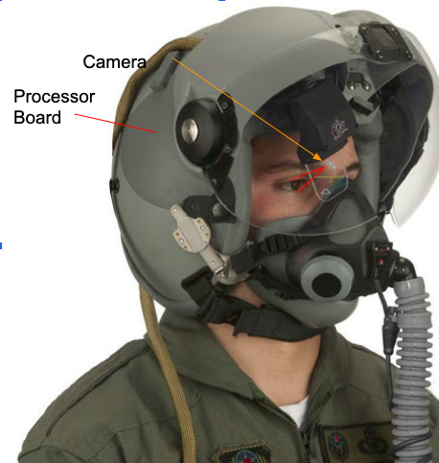
Camera Interface
Challenge: Cannot get the Daughter card (MIPI adapter for Ultra 96) due to the coronavirus
Solution & current situation:
Use PCB123 to create a new daughter card
Create bill of materials - a spreadsheet in google with a list of parts
learn to use PCB123
Things we already done:
Connecting and using USB camera for Ultra 96
Trade study on Camera Interface:
1) USB camera, MIPI camera
2) Suitable MIPI camera interface： Raspberry PI OV5647
Xuewen (1)

Slide 4
Future Plan for Camera Interface
Create new schematic for the daughter card design
Buy parts and PCB, Solder parts to the PCB, Test the design
Connect MIPI Camera to the Ultra 96 and support the team do the testing
Xuewen (2)

Slide 5
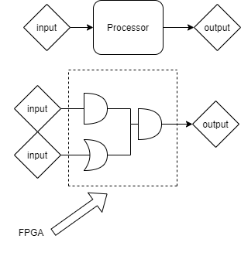
FPGA in Machine Learning
In our project we are going to use FPGA(field-programmable gate array) to accelerate inference of the machine learning algorithm.
We are using various methods to optimize machine learning algorithm, like pruning, choose the best parameters, data pre-manipulation, and FPGA.
FPGA can do parallel computation(processor only do sequential computation)
Audio link:
https://drive.google.com/file/d/1xlCm3028vBhH4zvwfMxUdgS4ETwyDAHn/view?usp=sharing

Slide 6
Learning process and final goal for our project(FPGA part)
I try to understand how ML(Machine learning) worked. (Open closed eye).
I was challenged to use our data training BNN(binary-neural network).
Learn how to use Vitis and Vivado tools by finishing ‘Hello world’ project.
Get started to learn how DPU(Deep learning Process Unit) work.
Final goal is to use DPU do the calculation of the inference part on our board(ultra 96 v2).
Audio link:
https://drive.google.com/file/d/1tHH8hmqGd2ICVdx18zE5e4JndT1SVRSx/view?usp=sharing

Slide 7
Use image processing to improve performance
Two main possible ways to increase whole performance:
Improve the input image of the system:
Apply the image filter to reduce the interference and calculation --resize, noise reduction, overexposure...
Improve the system (algorithm) itself:
Use the pre-processed image to replace specific layer(s) in algorithm --Gabor filter
Different image filter may or maynot benefit the system, some may even have side effects, every filter used needs to be tested and examined first.
Jianhang Liu (1)

Slide 8
challenges on image processing & future plans
Challenges from improve input image of the system:
Final results from different image processing methods may vary: Some benefit the system, some did not changes, and some did bad effect. Choose filter parameter will directly affect the result.
Challenges from improve the algorithm itself:
Cannot observe the logic of algorithm directly, not easy to find the proper image filter to replace algorithm layers, may cause side effects if not handled properly.
Future plans: Do the image processing on both directions, take multiple trials and guess to achieve goals.
Jianhang Liu (2)

Slide 9
Make algorithm have less memory
In the beginning, we set a primary goal for the whole semester to make the algorithm have less size but only reduce a few accuracy rate. After that, transfer the code to the correct format that can successfully run in Ultra 96 board. I focused on the task this semester and got a pretty good result.
When I start to do the task, I search how to make the TensorFlow model got less size. After I read several essays, I choose to use the pruning method to do the task. Weight pruning means eliminating unnecessary values in weight tensor. Users can get a pruned model in the end.
Sicheng Zeng（1）

Slide 10
Prune challenge
I use TensorFlow and Keras in the pruning process. During pruning, two elements are most important, which are sparsity and schedule that directly affect final model result .
I set epochs,initial_sparsity, and final sparsity to achieve the best outcome that is less memory and more accuracy. During the process, I read lots of essay to learn new technology and try to do my best. I choose four epochs and 50% to 90% sparsity in the openclose_eye model by testing. In the end, I got a pruned model in my computer.
Sicheng Zeng（2）

Slide 11
Transfer to tensorflow lite and Run in Ultra 96
After pruning process, I got a pruned model. Now, I transfer the model to the TensorFlow Lite format, which is required for Ultra 96. After transfer, I got an 80% less size model with 84% accuracy in Ultra 96 board. I also learned who to run TensorFlow Lite on the board, but I can have one because of the coronavirus.
In the semester, we are all newbie for machine learning in the beginning. However, we grow into the area and seek better technology during the semester. Thank everyone help us in the semester.
Sicheng Zeng（3）

Slide 12
Setting up ultra 96-v2 inference metrics
Our project is improving the existing algorithm in terms of inferencing latency and memory usage, therefore setting up the proper metrics is a necessary and essential aspect that should be done early
Measured existing algorithm metrics, with quantization to 8 bit using tensorflow lite
Junjie Chen

Slide 13
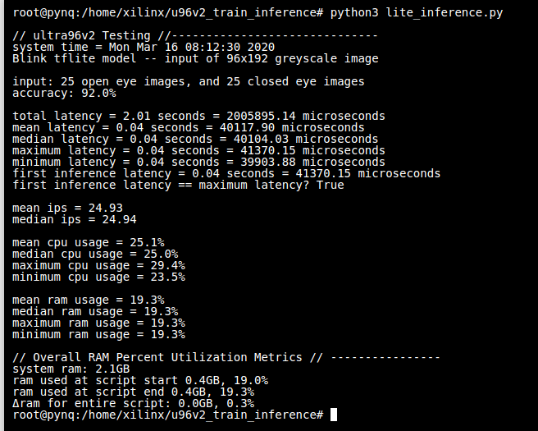
Inferencing baseline with tf-lite
Junjie Chen

Slide 14
Improving algorithm with hardware acceleration
FPGA has great advantage in terms of flexibility
Massive parallelism comparing to CPU
Using existing framework ‘PYNQ-BNN’ from Xilinx
Binary weights and hardware acceleration
Pre-manipulated data to required forms and promising inferencing speed, with some drops in accuracy
Junjie Chen

